Slide 1
Cassandra Overview
29/11/2017

Slide 2
SQL v/s No SQL Databases
SQL | NOSQL
Relational | Non Relational
Structured data type | Non structured data, such as Photos, Videos, Articles, etc
Supports powerful query language. Fixed schema. Supports transactions. | Supports simple query language. No fixed schema.Does not support transactions.
MySQL, Oracle, IMB DB2, Sybase, My SQL server, Microsoft Azure, Maria DB, Postgre SQL | Mongo DB, Apache’s Couch DB, Hbase, Oracle nosql,Apache’s Cassandra DBS

Slide 3
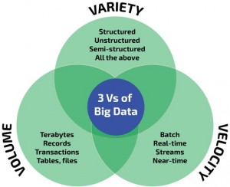
Volume , Variety , Velocity

Slide 4
Types of No sql databases
Key value Stores : Cassandra, DynamoDB etc
Column Stores : HBase, BigTable and Hypertable
Document Stores: MongoDB, Couchbase
Graph database : Polyglot

Slide 5




History of Cassandra

Slide 6
Features of Cassandra
Distributed: Capable of running on multiple machines while appearing to users as a unified whole.
Decentralized : Cassandra has no single point of failure. All of the nodes in a Cassandra cluster function exactly the same.
Elastic scalability :the ability to add nodes without going down produces predictable increases in performance.
High availability and fault tolerance: It is easy to remove a node from the cluster without affecting the cluster.
Flexible data storage :Cassandra accommodates all possible data formats including: structured, semi-structured, and unstructured.
Tuneable Consistency
Open source

Slide 7
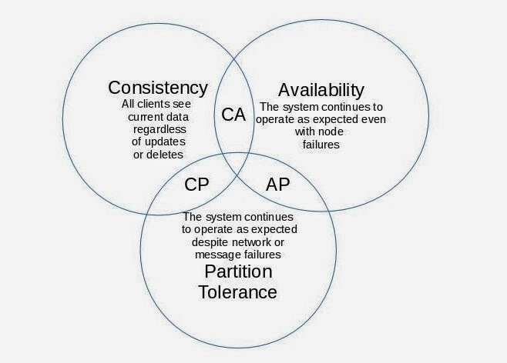
Brewer’s CAP theorem

Slide 8
Data model of Cassandra
Node
Node : It is the place where data is stored.
Data center: A collection of related nodes.
3000-5000 transactions per core
Node1
Node2
Node3

Slide 9
Clusters : Collection of one or more data centers.
Node1
Node2
Node1
Node2
Node3
Node3
Node 5
Node 4
Data center 1
Data center 2

Slide 10
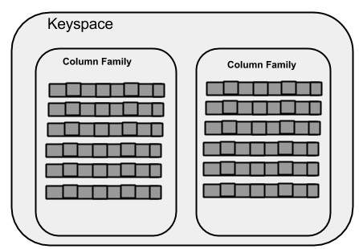
Keyspaces : It is the outermost container for data in Cassandra.
Column family : A column family is a container for an ordered collection of rows. Each row, in turn, is an ordered collection of columns.

Slide 11
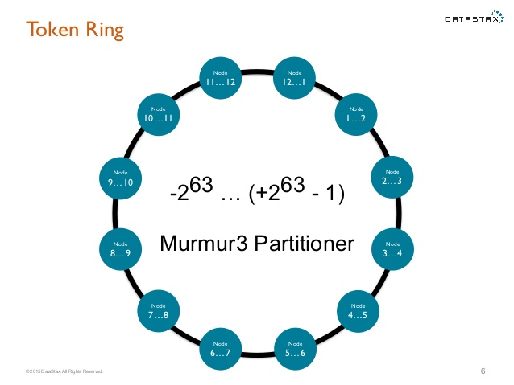
Cassandra Architecture
1. Partitions : Grouping of data.
Partitioners: Determines how data is didtributed across the nodes in the cluster.
2. Rings and tokens :

Slide 12
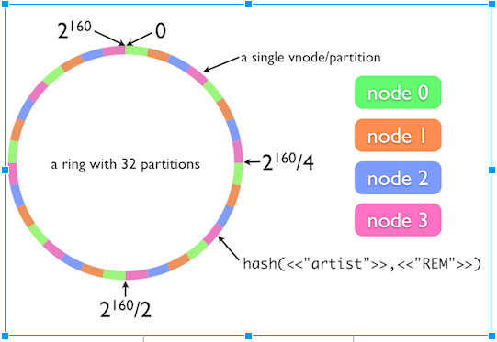
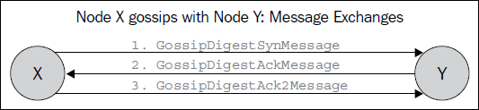
3. Virtual Nodes : These nodes change the paradigm of one token or range per node to many tokens or range per node.
Gossip protocol : Cassandra uses gossip protocol that allows each node to keep track of state information about the other nodes.

Slide 13
5. Snitches : A snitch determines which datacenters and racks nodes belong to.
Regular snitch :
SimpleSnitch The SimpleSnitch is used only for single-datacenter deployments.
PropertyFileSnitch Determines the location of nodes by rack and datacenter.
GossipingPropertyFileSnitch Automatically updates all nodes using gossip when adding new nodes and is recommended for production.
6. Replication : Cassandra stores replicas on multiple nodes to ensure reliability and fault tolerance. A replication strategy determines the nodes where replicas are placed.
Two replication strategies are available:
SimpleStrategy : Used for single data center and one rack.
NetworkTopologyStrategy : Used for multiple data centers.

Slide 14
7. Consistency levels: Cassandra provides tuneable consistency.
A higher consistency means more nodes needs to respond.
A read consistency specifies how many nodes should respond to a read before returning the data.
A write consistency level specifies how many nodes should respond for a write to be successful.
ALL
ANY
ONE,TWO,THREE
QUORUM
EACH_QUORUM
LOCAL_QUORUM
LOCAL_ONE

Slide 15
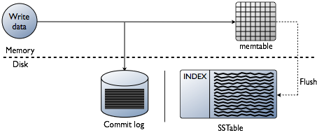
Commit logs : Commitlogs are an append only log of all mutations local to a Cassandra node. Any data written to Cassandra will first be written to a commit log before being written to a memtable. This provides durability in the case of unexpected shutdown.
Memtables: Memtables are in-memory structures where Cassandra buffers writes. In general, there is one active memtable per table. Eventually, memtables are flushed onto disk and become immutable SSTables.
SSTables: SSTables are the immutable data files that Cassandra uses for persisting data on disk.

Slide 16
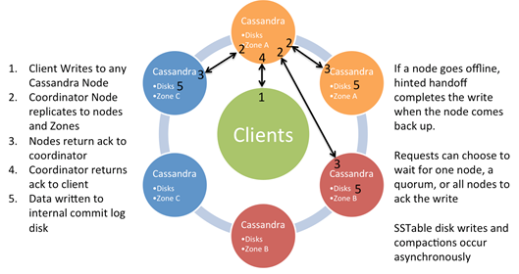
Write Path

Slide 17
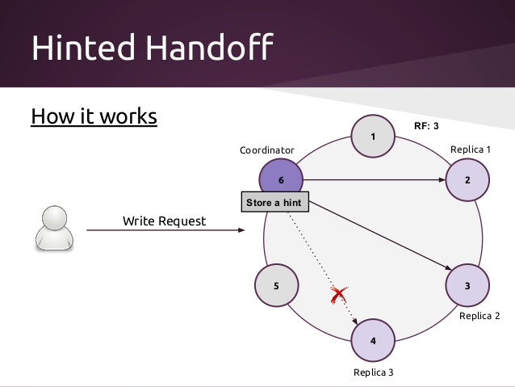

Slide 18
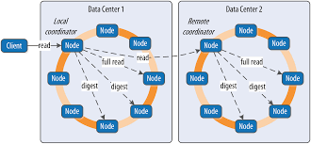
Read Path

Slide 19
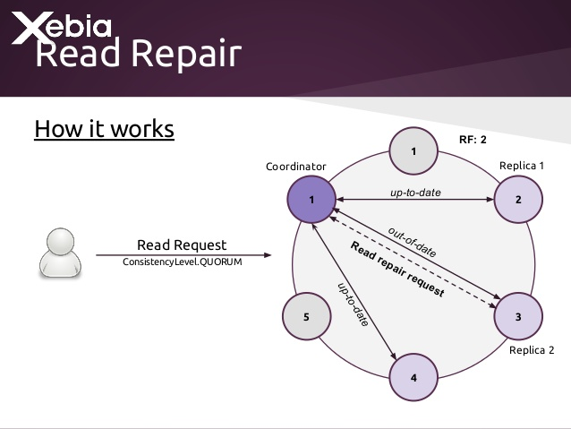
Read Repair

Slide 20
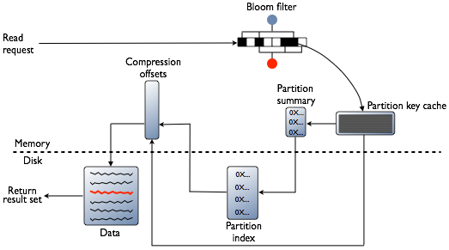
Read path in SSTable

Slide 21
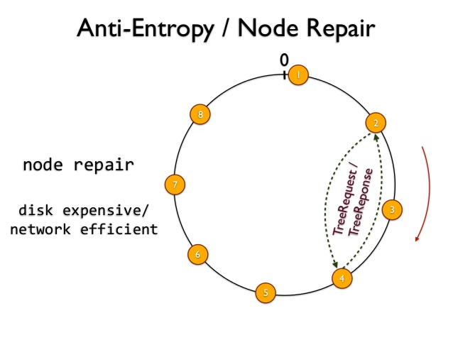
Repairs
Why repairs?
Anti-Entropy Repairs- Manual repairs

Slide 22
Type of repairs
Full repair
Incremental repair
Sequential and parallel repairs
Primary range repairs
Subrange repairs

Slide 23
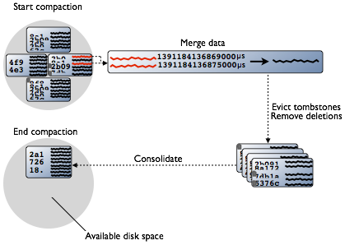
Compaction

Slide 24
Types of compactions
Minor compactions:
Major compactions :
Compaction Stratergies
SizeTieredComapctionStratergy(STCS):
LevelCompactionStratergy(LCS):
DateTiered Compaction Strategy (DTCS):
UDC (User Defined Compactions)
Creates a compaction task for one or more tables explicitly. This task is then handed off to the Cassandra runtime to be executed like any other compaction.

Slide 25
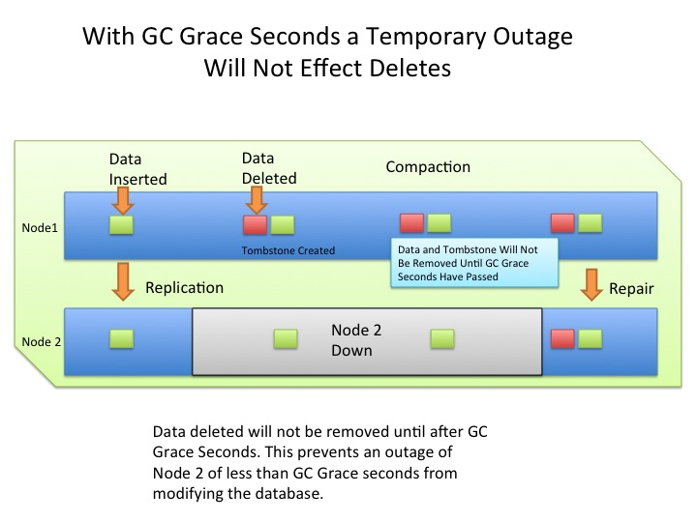
Tombstone

Slide 26
Monitoring
KPI
Down nodes
Throughput, especially read and write requests.
Latency, especially read and write latency.
Disk usage, especially disk space on each node.
Garbage collection frequency and duration.
Errors and overruns, especially unavailable exceptions which indicate failed requests due to unavailability of nodes in the cluster.

Slide 27
Subrange Repair Script WRT BA & BC
BC :
CSC1 :
META : mtlmet{01..09} tormet{01..09} - uses “imail2” user. One META instance per server. BLOB : mtlcsh{01..20} torcsh{01..20} - Uses "imail1", and "imail3" users.
CSC2 :
META : mtlcsh{23..45} torcsh{23..45} - Uses "imail5" user. One META instance per server.
BLOB : mtlcsh{23..45} torcsh{23..45} - Uses "imail1", "imail2", "imail3", and "imail4" users. Four BLOB instances per server.

Slide 28
On BC, the subrangerepair script is on all the nodes. It just runs for Meta so imail2 user on CSC1 and imail5 user on CSC2 (only for MONTREAL nodes).
They usually complete in less than 12 hours so we don't need to worry about overlapping as long as we have them run on different days.

Slide 29
Running only for Meta
CSC1 - for imail2 user
mtlmet{01..09}
mtlmet01 - 0 23 * * 0 cd $HOME/cron && $HOME/bin/run_subrangerepair
mtlmet02 - 0 23 * * 1 cd $HOME/cron && $HOME/bin/run_subrangerepair
mtlmet 09 - 0 23 * * 0 cd $HOME/cron && $HOME/bin/run_subrangerepair
tormet{01..09}
tormet01 - 0 23 * * 3 cd $HOME/cron && $HOME/bin/run_subrangerepair
tormet02 - 0 23 * * 4 cd $HOME/cron && $HOME/bin/run_subrangerepair

Slide 30
CSC2 -
mtlcsh{23..45}
mtlcsh23 - 0 21 * * 1 cd $HOME/cron && $HOME/scripts/run_subrangerepair
mtlcsh24 - 0 21 * * 2 cd $HOME/cron && $HOME/scripts/run_subrangerepair
mtlcsh25 - 0 21 * * 3 cd $HOME/cron && $HOME/scripts/run_subrangerepair
torcsh{23..45}
Not Running -

Slide 31
BA :
META :
TR1 : tr1cass{01..08} - Uses "imail" user.
TR2 : tr2cass{01..08} - Uses "imail" user.
BLOB :
TR1 : tr1cass{01..08} - Uses "imail1" and "imail2" users. Two BLOB instances per server.
TR2 : tr2cass{01..08} - Uses "imail1" and "imail2" users. Two BLOB instances per server.r.

Slide 32
for BA, Each nodetool repair takes about 48-56 hours so we need them to run after another and dont want any repair to overlap.
Script run via Root user for imail1 and imail2.

Slide 33
Frequent issues :
High Load
Latency, especially read and write latency.
Down nodes
Disk usage, especially disk space on each node.

